Slide 1
Unsupervised Data Mining Methods using R
Sharanjit Kaur
Acharya Narendra Dev College
University of Delhi

Slide 2
Topics to be covered
Data pre-processing
Clustering
Association rules mining

Slide 3
Data Pre-processing
Cleaning data before extracting useful patterns
Why to clean?
Incomplete, incorrect and noisy
Data cleaning
Data transformation
Data pre-processing in R

Slide 4
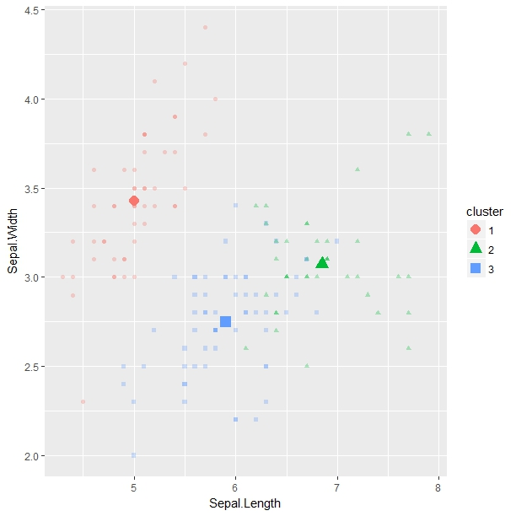
Clustering
Partitioning a set of data points into a set of meaningful and natural groups called as clusters
Unsupervised classification i.e. no predefined classes in data
Cluster is a subset of data which are “similar” than the rest of data points in other clusters

Slide 5
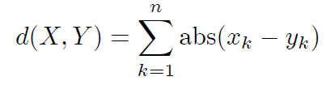
Distance measures
Euclidean
Manhattan

Slide 6
Minkowski
where r is some parameter
if r=1, then Manhattan distance
if r=2, then Euclidean distance
if r=∞, then Supremum distance

Slide 7
Clustering
Partition based
K-means
DBSCAN
Hierarchy based
Divisive
Agglomerative

Slide 8
K-means Clustering
Partition based clustering used to detect fixed k partitions
Sensitive to outliers and noise in data
Works for numeric data
R script for K-means

Slide 9
DBSCAN
Density-based spatial clustering of data with noise
Does clustering based on connectivity and density
No need to predefine number of clusters
Requires two parameters minimum points (minpt), minimum radius (eps)
R script for DBSCAN

Slide 10
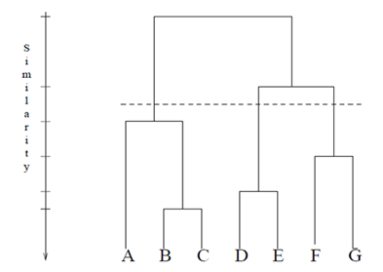
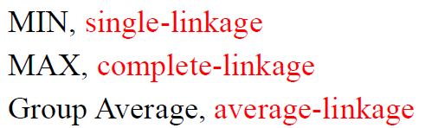
Hierarchical Clustering
Hierarchical decomposition of the set of data points using some criterion
Build a tree-based hierarchical taxonomy, dendrogram from a set of unlabelled examples
May be result of recursive application
of a standard clustering algorithm
Similarity in two groups
R script for Hierarchical clustering

Slide 11
Association Rule Mining
Mines frequent patterns, correlations, associations, or causal patterns from transaction data
Finds rules used to predict the occurrence of a specific item based on the occurrences of the other items in the transaction
Apriori algorithm
identifies the frequent items individually in the dataset and extends them to larger and larger item sets

Slide 12
AR Evaluation Metric
Assuming rule {A} -> {B} is given, then
Support
Fraction of transactions that contain both A and B
P(AB)
Confidence
Measures how often each item in B appears in transactions that contain A
P(AB)/P(A)
Lift
confidence of the rule divided by the expected confidence
P(AB)/P(A)P(B)
R script for Apriori algorithm

Slide 13
References
R and Data Mining: Examples and Case Studies, Yanchang Zhao, http://www.RDataMining.com
Practical Statistics for Data Scientists: 50 Essential Concepts, Peter Bruce and Andrew Bruce, O'Reilly Media, 2017
Data Mining with R: Learning with Case Studies, Vipin Kumar, CRC Press, 2010
An introduction to data cleaning with R, Edwin de Jonge and Mark van der Loo, Statistics Netherlands, 2013

Slide 14
Thanks!!
Questions Please !!

